Slide 1
Comets, Asteroids and Meteors

Slide 2
What I need to know
Students should be able to explain how a comet is formed
Should know how to describe a comet, asteroid and meteor
Students should know the difference between the terms meteoroid, meteor and meteorite
Students should know to find comets, asteroids and meteors in the solar system

Slide 3
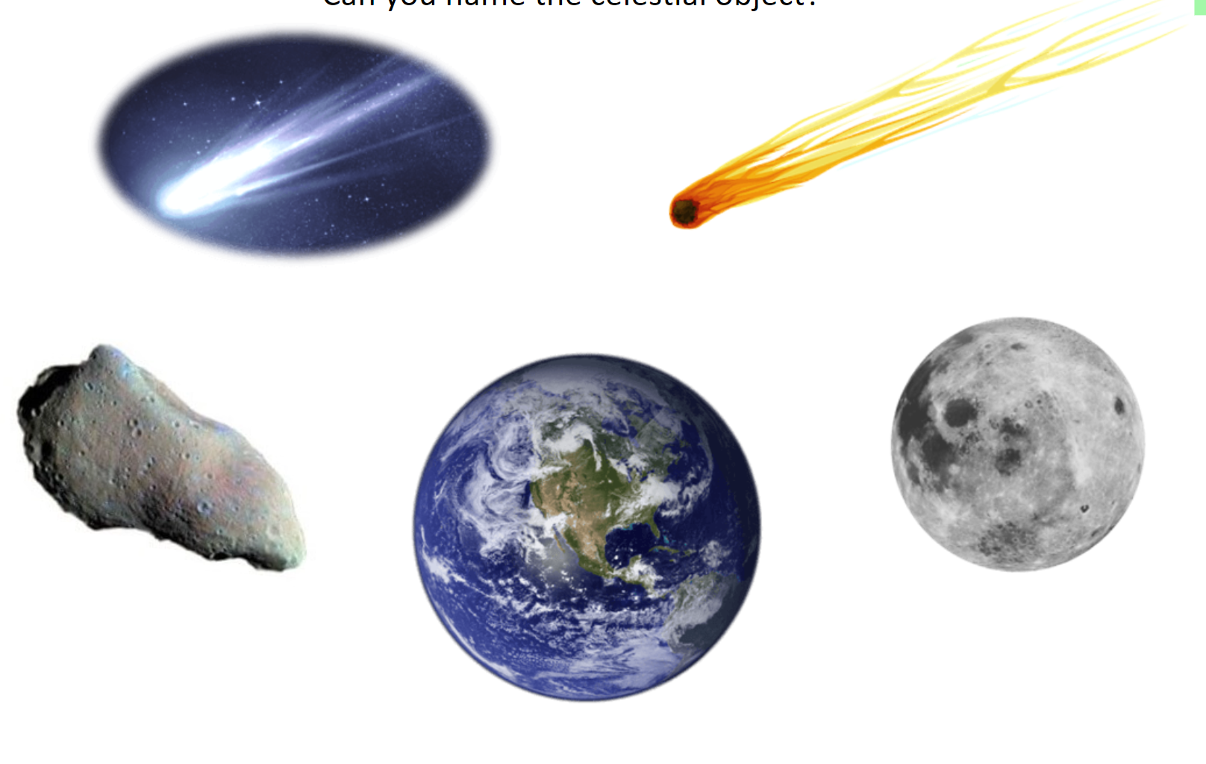
Can you name the celestial object
Notes:
something in space, such as a star or planet.

Slide 4
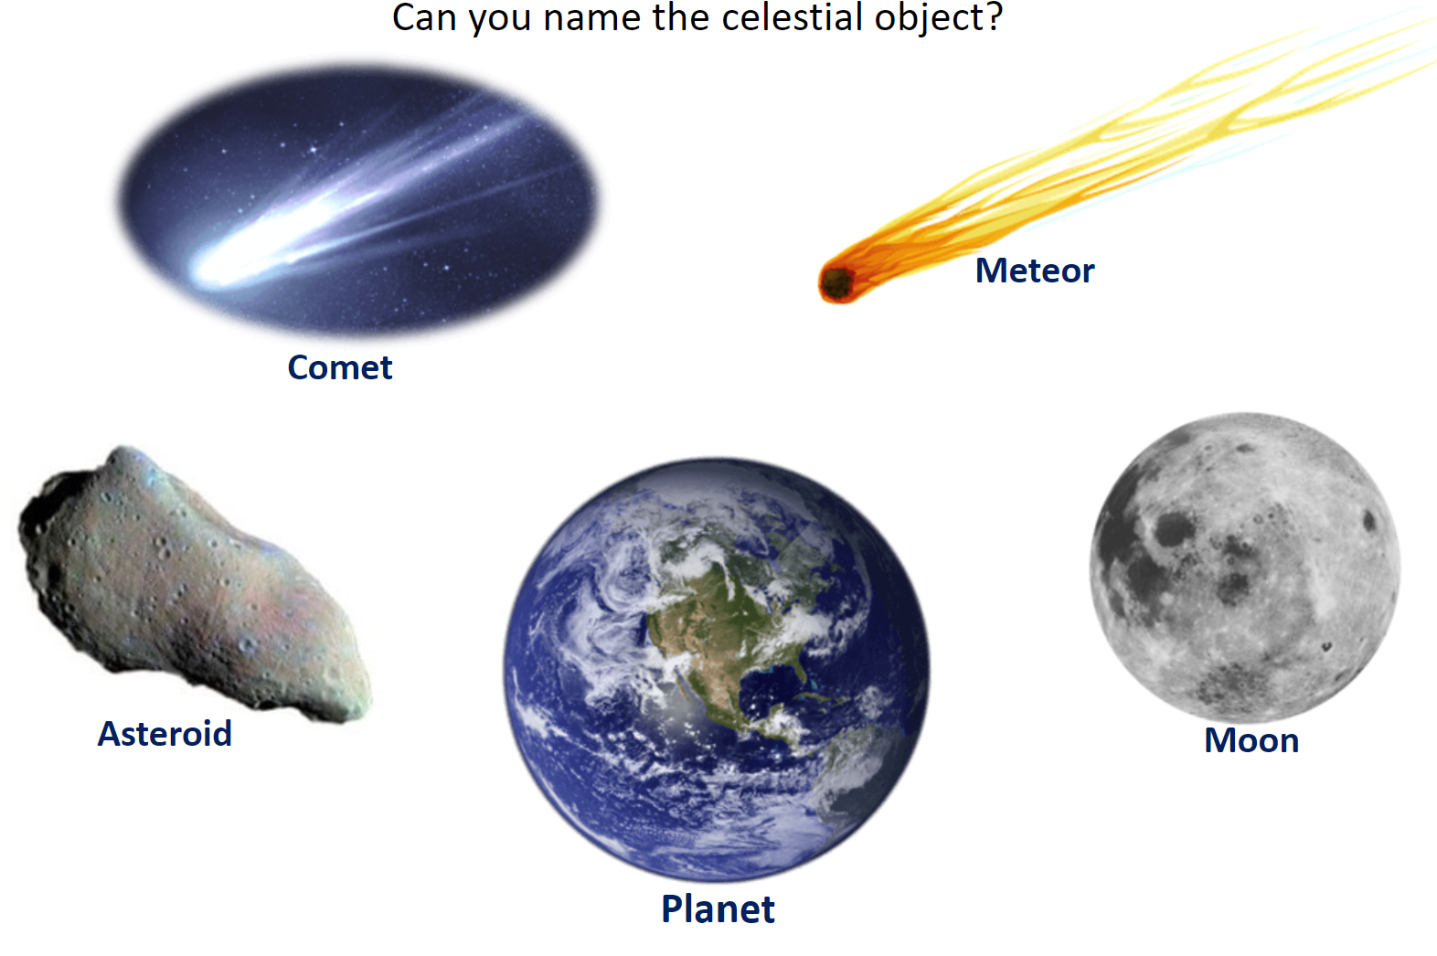
Can you name the celestial object

Slide 5
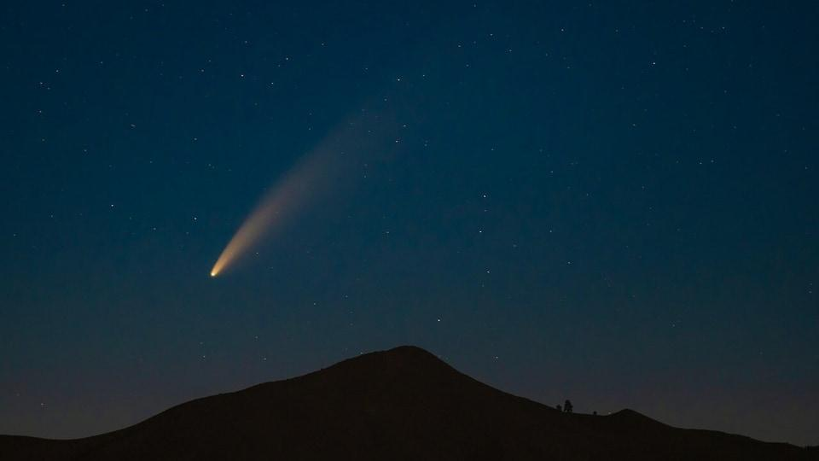
What is a comet

Slide 6
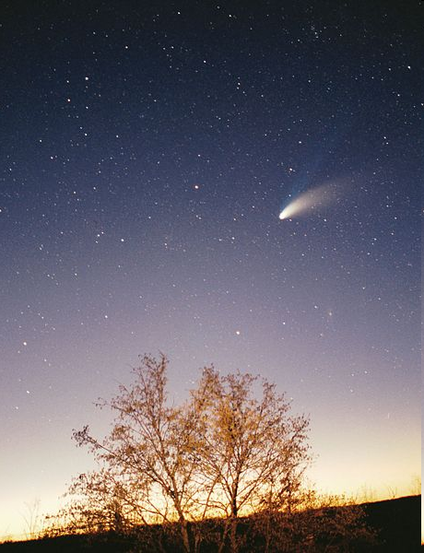
Comets
Large lumps of frozen gases rock and dust
• Comets are made of ice and dust.
• They orbit the sun in a circular motion and spend most of their time in the outer reaches of the solar system.
• When comets get close to the sun, tails of gas and dust particles are emitted.
Depending on the comet, it can take 200 years to 30 million years to orbit the sun.
Notes:
Located a great distance from the heat energy of the sun

Slide 7
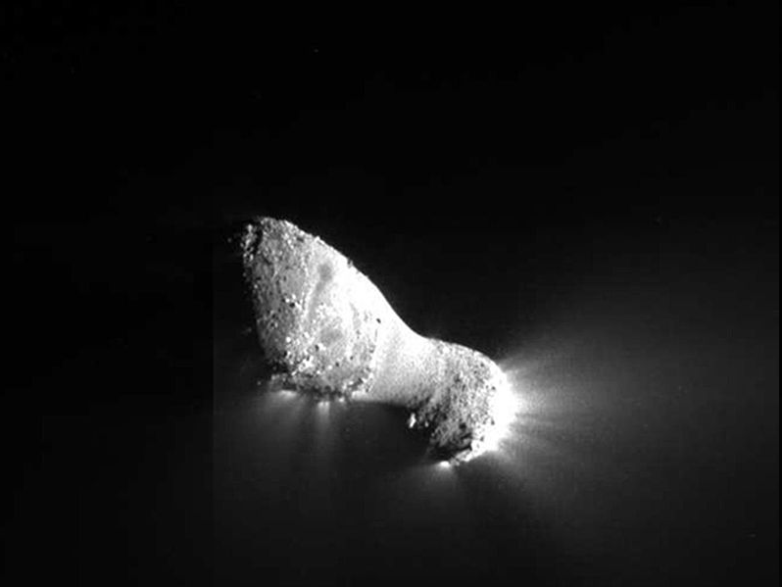
.
It is ~2km in length and 400m wide at its narrowest point.

Slide 8
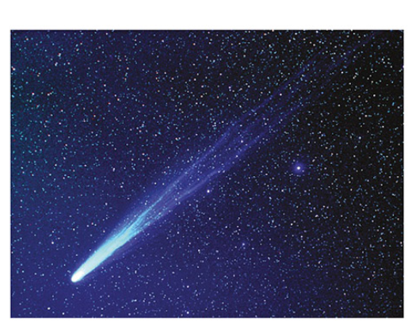
Comet and its tail
Then the suns heat energy evaporates the comets ice. This sends dust and gases out into space- form into a giant glowing head with a long tail.
The tail can stretch out for millions of miles behind the comet
Notes:
Comets look like solid objects until their orbit brings them close to the sun.
Then the suns heat energy evaporates the comets ice. This sends dust ang gases out into space- form into a giant glowing head with a long tail.
The tail can stretch out for millions of miles behind the comet

Slide 9
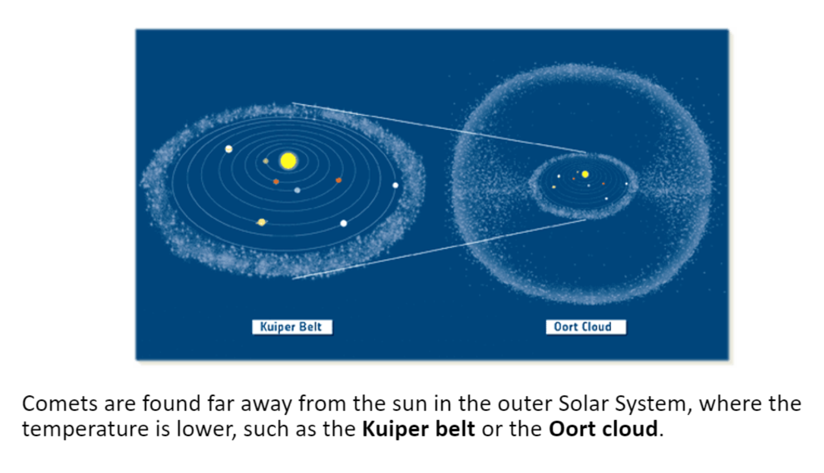

Slide 10
Comets originate from two areas of our solar system
The Kuiper belt
The Oort cloud
Located beyond the orbit of Neptune.
It contains short period comets, whose orbit of the sun is less than 200 years.
Located in the outer limits of the solar system.
It contains long period comets, whose orbit of the sun is from 200 – 200 million years.

Slide 11
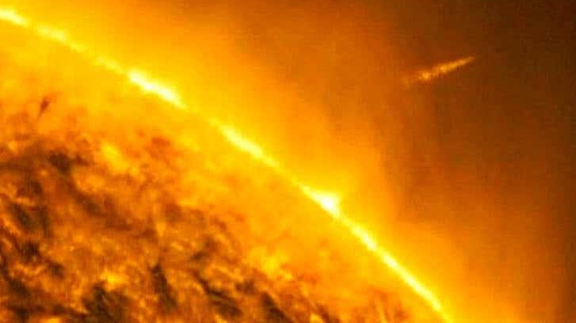
What would happen if a comet came close to the sun ?
Where do you think comets could be found in the solar system
Notes:
The nucelus of the ice/ dust would melt
When a comet comes close to the sun, the heat causes the solid ice to turn into gas vapor

Slide 12
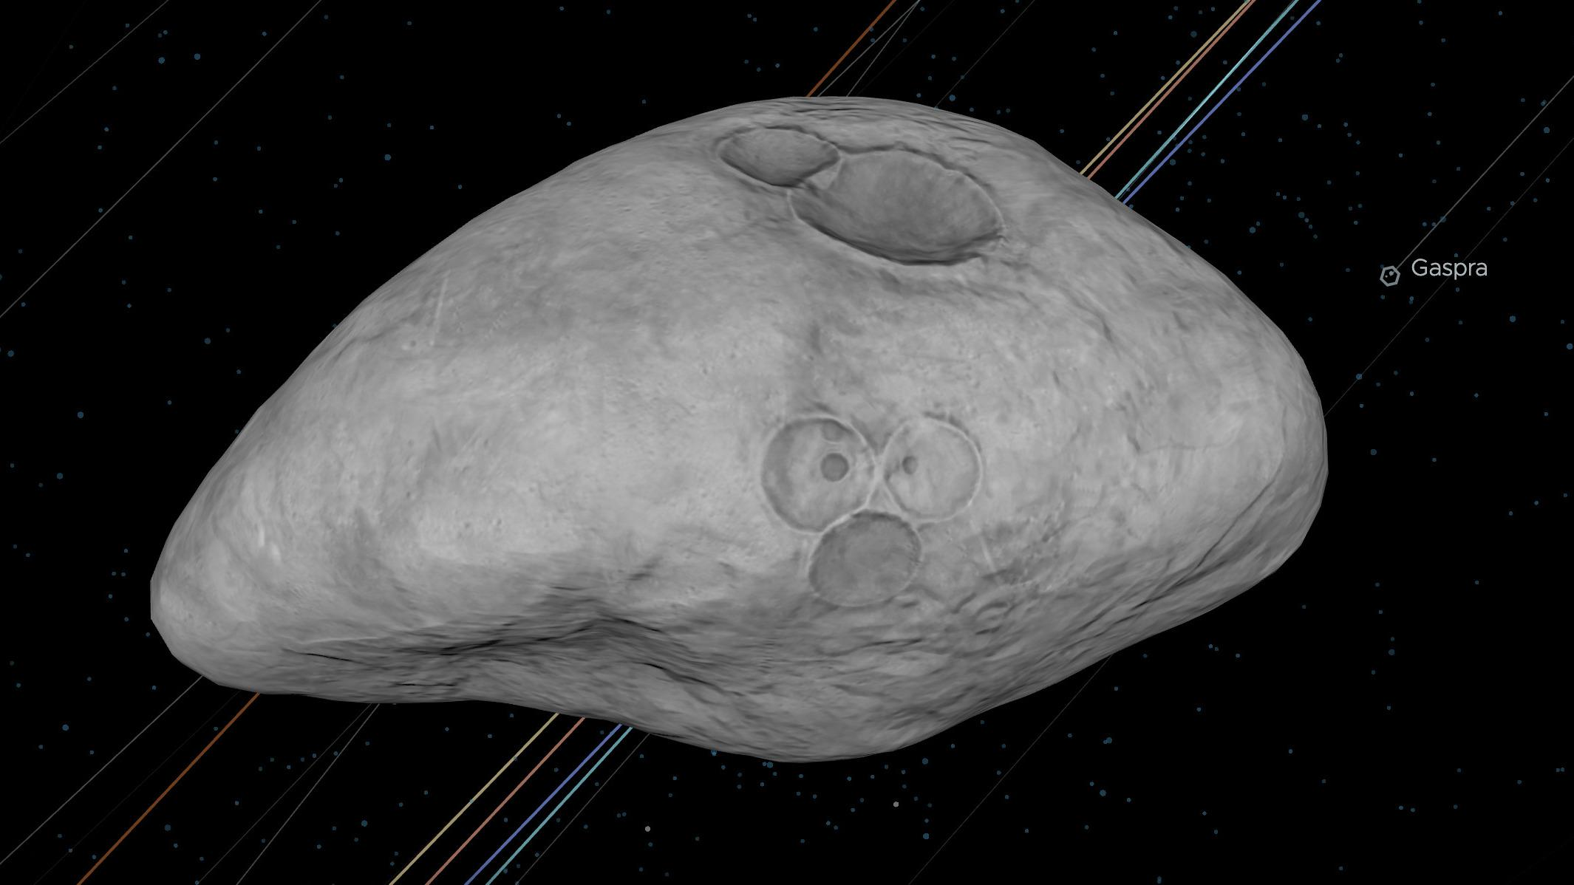
What is an asteroid

Slide 13
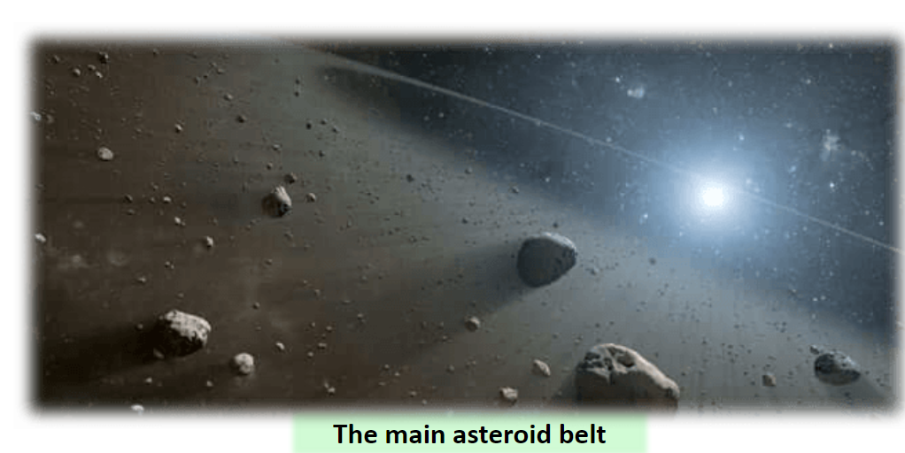
Asteroid
Apart from comets there are other small objects that exist within our solar system, these are asteroids.
Are small, rocky structures that have no air or no atmosphere.
They are located in the solar system's asteroid belt, which lies between Mars and Jupiter.
Notes:
Made up of rock form left over from the formation of planet 4.5 bn years
Ceres used to be an asteroid in the solar system until 2006 until it was reclassified as a dwarf planet like pluto

Slide 14
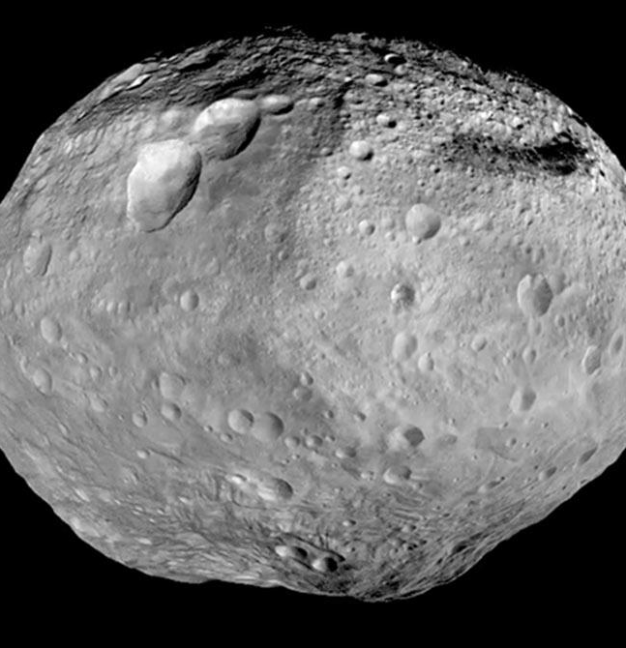
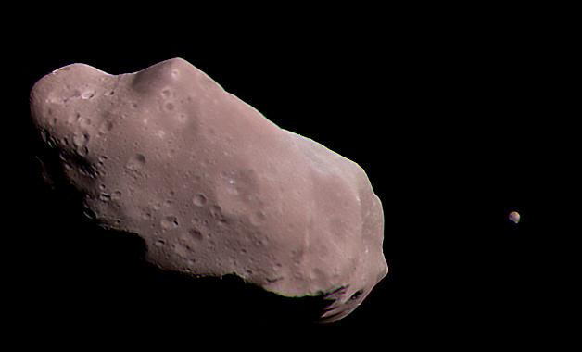
Asteroids vary in size
Some asteroids are as small as 10 m diameter, these are known as meteors.
Some asteroids are large at about 100 km diameter, these are known as planetoids.

Slide 15
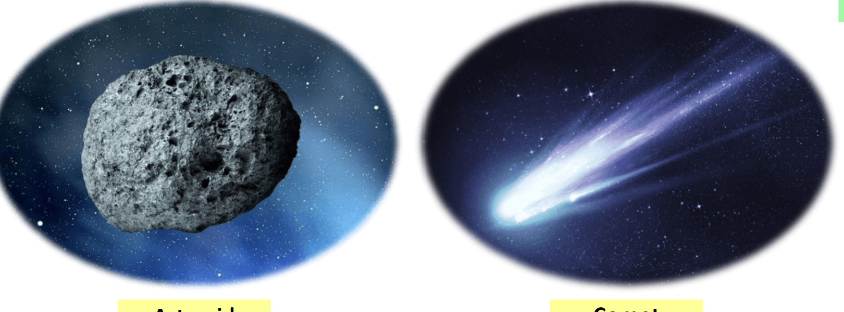
Comet
Asteroid
Made up of _______, _________ and ________.
They are mainly located in the _______ solar system on the k_____ b______ or o________ c______.
Has no _____ or no_______.
They are mainly located in the solar system in the main asteroid _____ that lie between ________ and mars.
Notes:
Gas ice and dust
Kuiper belt
Oort cloud
Rock and metal
Inner and blet

Slide 16
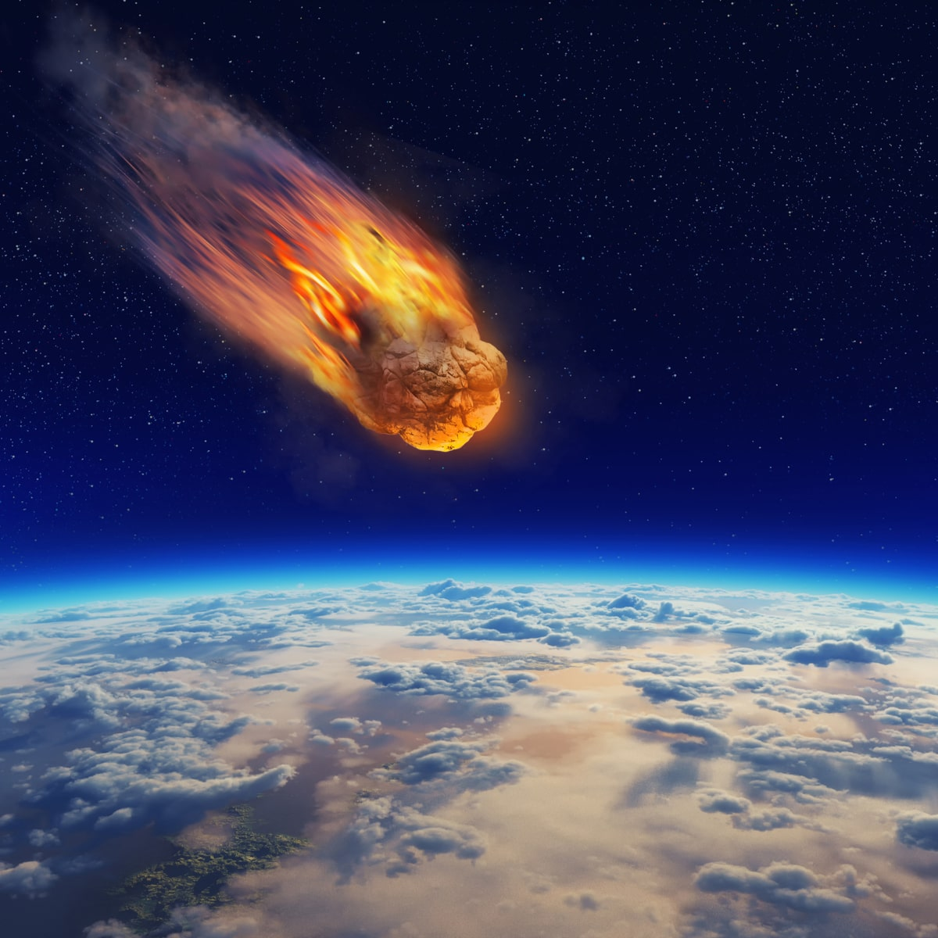
Meteor
Small rocks that burn up in the earth's atmosphere.
When a meteor enters the earth's atmosphere, it burns up due to the speed of its entry, leaving a streak of light.
This is a meteor or known as shooting star.

Slide 17
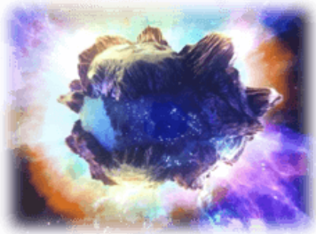
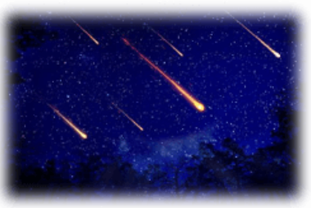
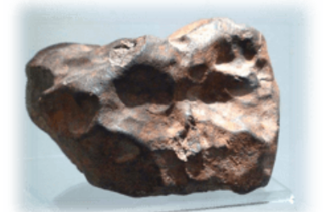
The journey of a meteoroid
Meteoroid
Meteor
Meteorite
Much smaller rock or particles that orbit the sun
When a meteor enters the earth's atmosphere, it burns up due to the speed of its entry, leaving a streak of light.
This is a meteor or known as shooting star.
If a meteoroid survives the passage through earth's atmosphere and lands on the surface it is known as a meteorite.
It’s the remainder of meteoroid that lands on earth.

Slide 18
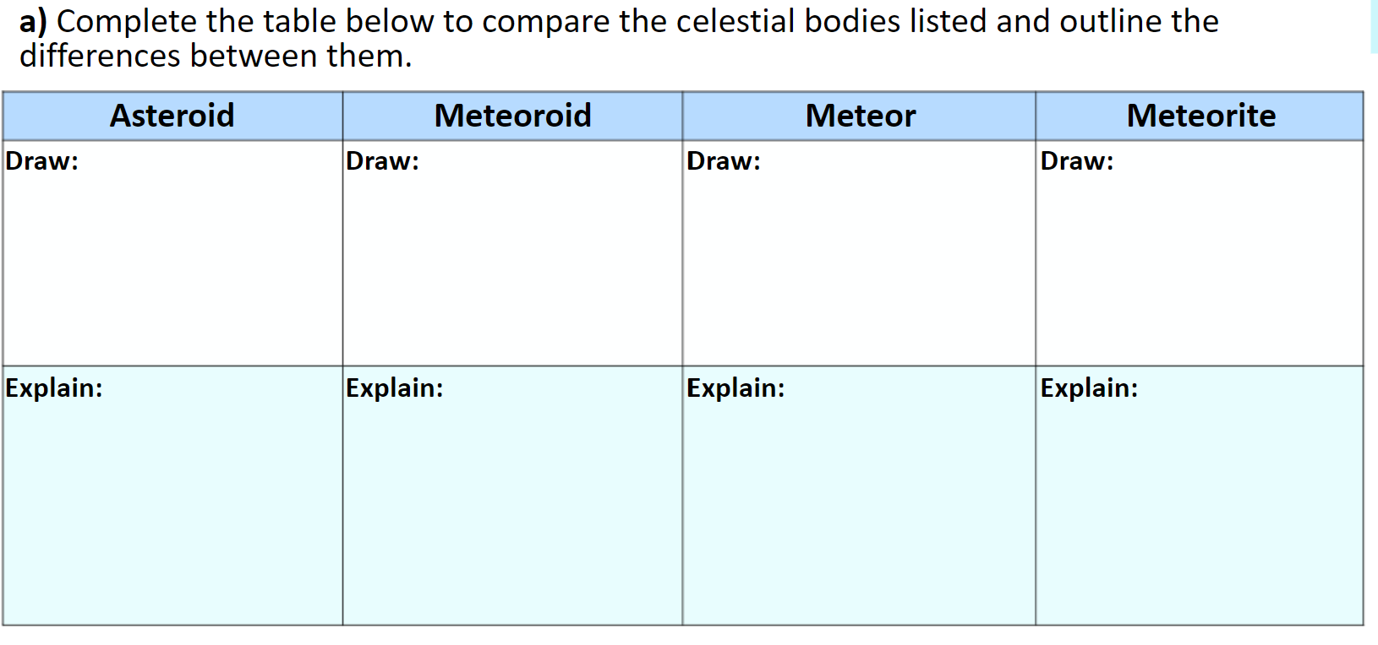

Slide 19
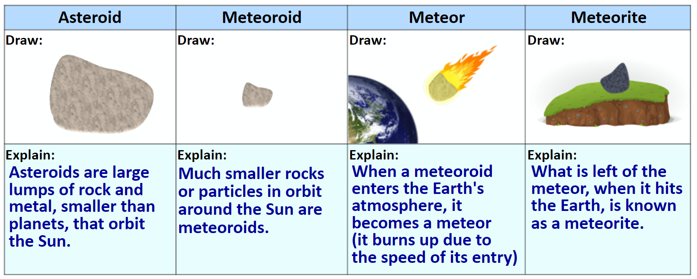

Slide 20
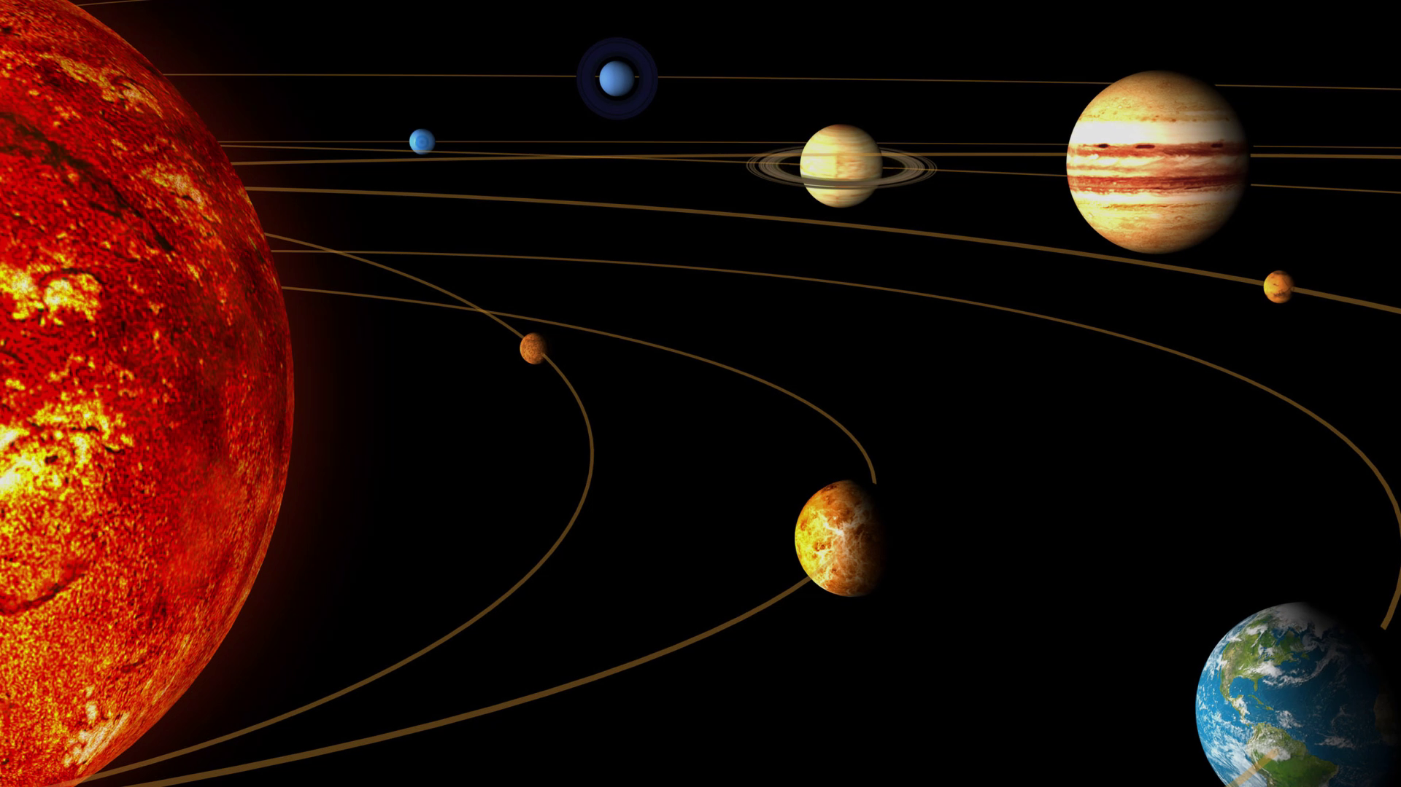
Where would you find comets, asteroids and meteors in the solar system

Slide 21
